Slide 1
English
Unit 2 – Sport
Tuesday 29th September 2026
WALT:To plan a biography.

Slide 2



WALT: To plan a biography.
I can use the tablet to plan a biography.
I can include the present simple and present perfect tense in my biography plan
I can include quotes correctly in my biography plan.

Slide 3
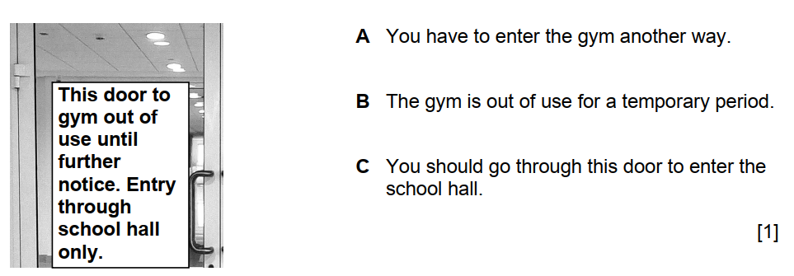
Retrieval Practice
WALT: To plan a biography.

Slide 4
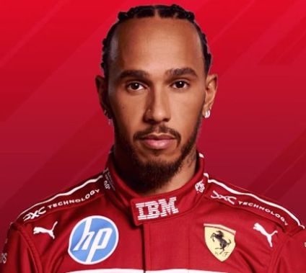
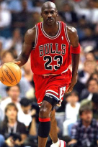
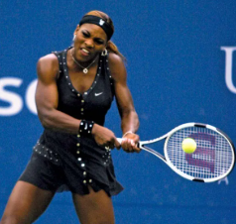
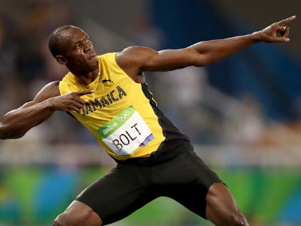
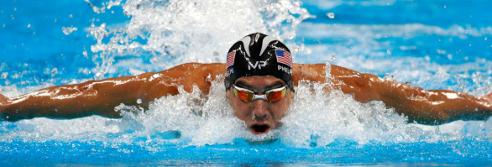
Starter –
Lewis Hamilton
WALT: To plan a biography.
Today, we will plan a biography.
You need to pick one of the sports stars below to research and then write about.
Michael Jordan Serena Williams Usain Bolt
Michael Phelps

Slide 5
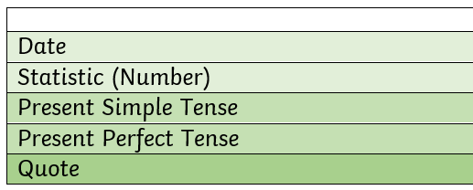
WALT: To plan a biography.
Lewis Hamilton
Today, we will plan a biography.
I have chosen Lewis Hamilton as the person I want to write my biography on.
My biography will need to include different features.

Slide 6
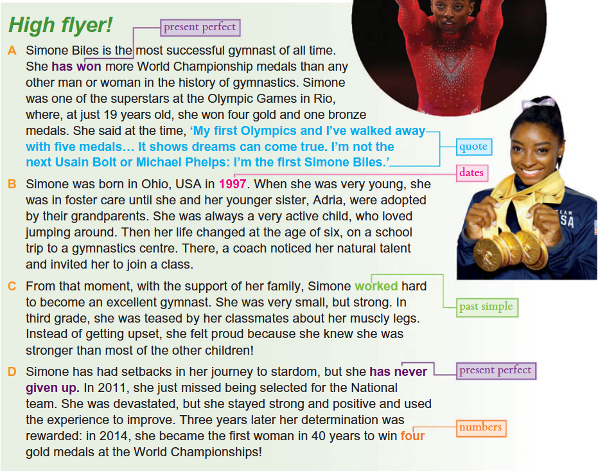
WALT: To plan a biography.
Let’s read the text.
Can you spot the features?

Slide 7
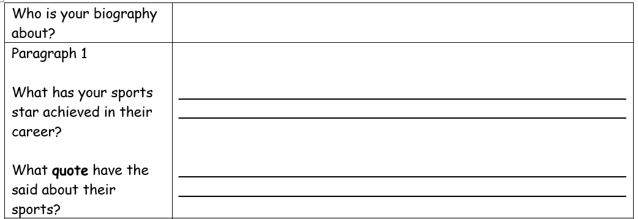
WALT: To plan a biography.

Slide 8
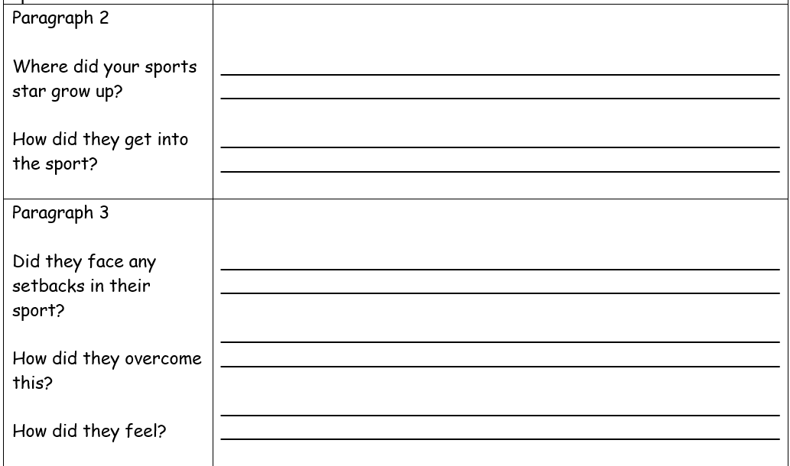
WALT: To plan a biography.

Slide 9
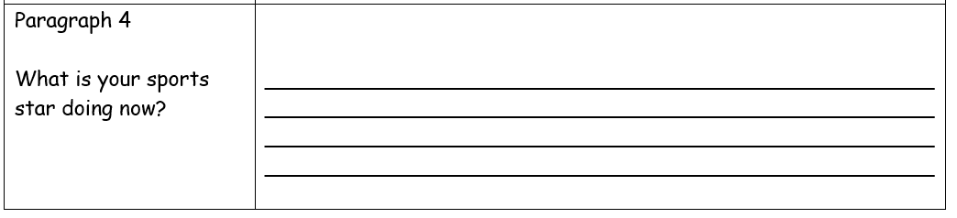
WALT: To plan a biography.

Slide 10
WALT: To plan a biography.
If you have finished, write 3 sentences in your book that you could use tomorrow using the PRESENT PERFECT tense.
Then, research the meaning of any word you do not know and write it into your book.

Slide 11
WALT: To plan a biography.
I can use the tablet to plan a biography.
I can include the present simple and present perfect tense in my biography plan
I can include quotes correctly in my biography plan.

Slide 12
English
Unit 2 – Sport
Thursday 1st October 2026
WALT: To write a biography.

Slide 13
WALT: To write a biography.
I can include dates and statistics in my biography.
I can use the present simple and present perfect tense correctly in my biography.
I can include quotes correctly in my biography.

Slide 14
Retrieval Practice
What is wrong with the sentence?
Lewis Hamilton had faced lots of challenges in his career.
WALT: To write a biography.
Lewis Hamilton had faced lots of challenges in his career.

Slide 15
Starter:
Have a look at your plan. Is it completed?
I want you to write 2 sentences from your plan that you could use in your writing.
WALT: To write a biography.

Slide 16
A reminder…
A biography is a detailed written account of a real person's life written by someone else.
WALT: To write a biography.

Slide 17
F1 Legend
Early Beginnings
Overcoming Obstacles
Never Giving Up
WALT: To write a biography.
Now, come up with 4 subheading you can use in your biography.
If you’ve done that, come up with a title.
Or
Introduction & Main Achievements
Early Life & Childhood
Hard Work & Determination
Turning Setbacks into Success

Slide 18
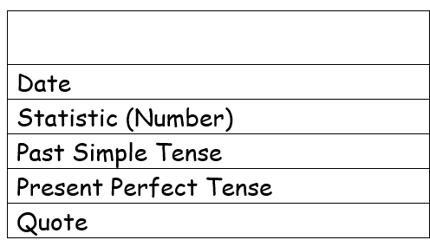
WALT: To write a biography.
Let’s read the text.
Have a look out for the features.

Slide 19
WALT: To write a biography.
Modelling

Slide 20
WALT: To write a biography.
I can include dates and statistics in my biography.
I can use the present simple and present perfect tense correctly in my biography.
I can include quotes correctly in my biography.

Slide 21
English
Unit 2 – Sport
WALT:
To edit a biography.

Slide 22
WALT: To edit a biography.
I can read through my work and identify the features needed.
I can edit my writing to make improvements.
I can read other people’s writing and support them to make edits.

Slide 23
What can we change about these sentences?
WALT: To edit a biography.
Michael Jordan is borned in 1963 where he growed up in North Carolina.
Serena Williams has won 39 titles in singles. She has won 4 Olympic gold medals. She has won 14 titles in doubles.

Slide 24
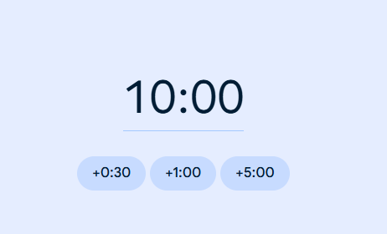
You’ve got 10 minutes to read through your work and make edits.
WALT: To edit a biography.
https://www.google.com/search?q=10+minute+timer&rlz=1C1MIZP_enVN1173VN1173&oq=10+mi&gs_lcrp=EgZjaHJvbWUqDQgAEAAYgwEYsQMYgAQyDQgAEAAYgwEYsQMYgAQyBggBEEUYOTIGCAIQBhhAMgcIAxAAGIAEMgcIBBAAGIAEMgoIBRAuGIAEGLQHMgcIBhAuGIAEMgcIBxAAGIAEMgcICBAAGIAEMgcICRAAGIAE0gEIMjEzOGowajeoAgCwAgA&sourceid=chrome&source=chrome.ob&ie=UTF-8&safe=active&ssui=on

Slide 25
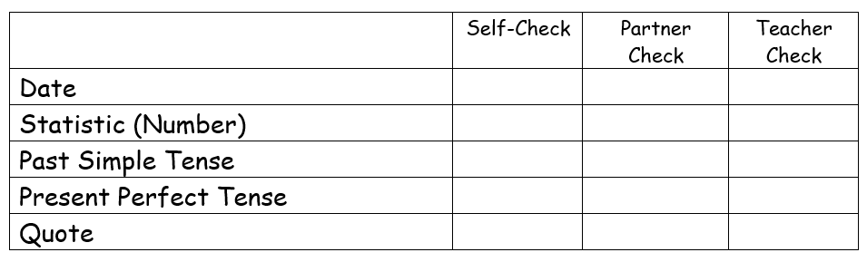
Now, we need to fill in our success criteria to ensure we’ve got all the features in our biography.
WALT: To edit a biography.

Slide 26
WALT: To edit a biography.
I can read through my work and identify the features needed.
I can edit my writing to make improvements.
I can read other peoples writing and support them to make edits.

